Slide 1
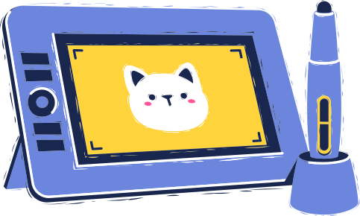
ANIMATION
BY: JASMIN RUTTER

Slide 2


WHAT IS ANIMATION
Illusion of motion through photographing drawings, models, or puppets
Frames are shown in fast succession
Brain blends frames into single moving image
Origin: hand drawn on translucent paper and photographed
Present: produced on blender, adobe animation, and unity

Slide 3




MORE THAN JUST DESIGN
Tells Stories
Fosters Collabs
Bridges Language
+
Cultural Barriers
Diverse Voices
+
Perspectives

Slide 4


PROBLEMS ANIMATION SOLVED
Educational Aid
Complex concepts are simplified through engaging visuals
Problem Solving
helps visualize realistic & imaginary physics scenarios
Simulation & Modeling
Helps people practice in a controlled environment
Cultural Preservation
documents and revives cultural heritage

Slide 5

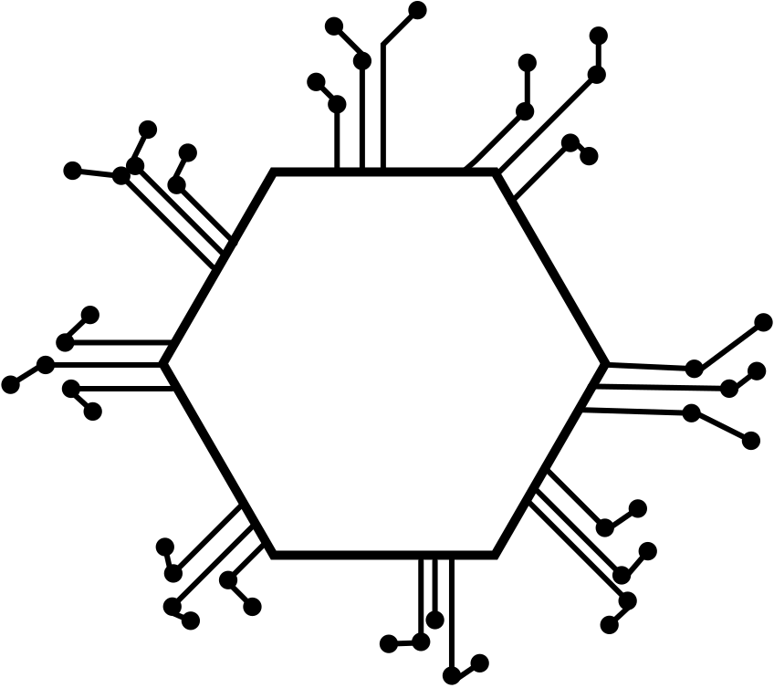
FUTURE TRENDS
Artificial intelligence
AR and VR
Create more interactive & immersive experiences
Globalization
more creators in different countries
more diversity in style, perspective, and storytelling
Streaming Services
Distribution & availability

Slide 6
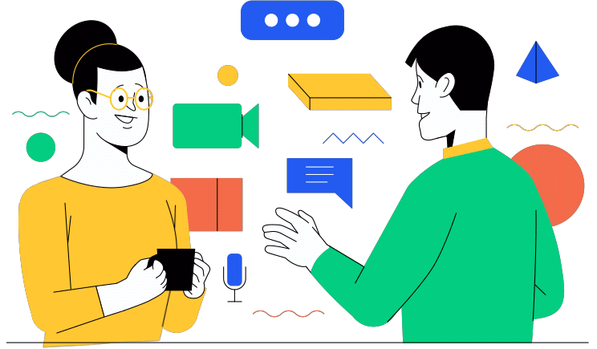
CONCLUSION
Animation is a powerful tool for a variety of purposes
Simplifies complex problems and deepens emotional connections
Future trends: tech advancements & increased distribution
Encourages artists to think outside the box
Animation will always be in demand as it creates endless opportunities

Slide 7
SOURCES
Avadmin. “Benefits of Using Animation in Education.” Alternative View Studios, Alternative View Studios & clients, 15 July 2022, avstudios.com/post/benefits-of-using-animation-in-education.
Gibson, Dylan. “Why Animation Is Important.” Stone Soup, Children’s Art Foundation–Stone Soup Inc., 2 July 2019, stonesoup.com/post/why-animation-is-important/.
Maio, Alyssa. “Video: Ultimate Guide to Animation - Types and Styles.” StudioBinder, STUDIOBINDER INC., 25 Sept. 2023, www.studiobinder.com/blog/what-is-animation-definition/.
Mok, Jeffrey. “Animation Thinking.” Medium, Domain Product Design, 30 Jan. 2019, medium.com/design-domain/animation-thinking-the-user-experience-13fa72dadb12.
Tiwana, Samra. “A Deep Dive into the Present and Future of Animation.” MotionCue, MotionCue, 21 Feb. 2023, motioncue.com/present-and-future-of-animation/#:~:text=AR%2FVR,animated%20worlds%20in%20new%20ways.
"Mulan (1998) Trailer #1 | Movieclips Classic Trailers." YouTube, uploaded by Rotten Tomatoes Classic Trailers, 14 March 2018, www.youtube.com/xxxxx

